Slide 1
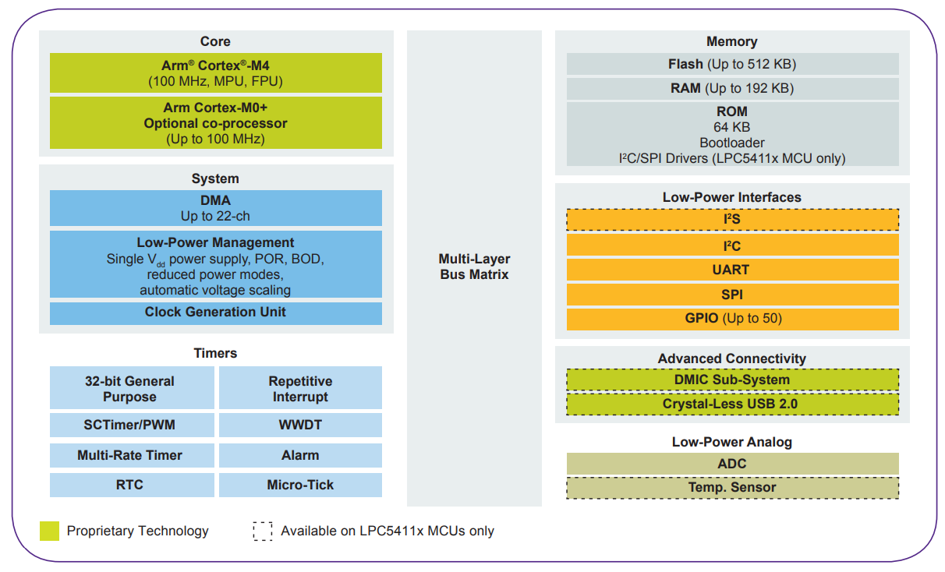

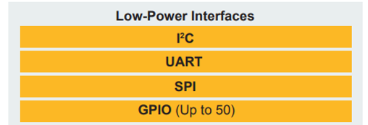
NXP LPC 54102J512
Coridium ARMbasic Runtime
ABrtos/
Main Setup/Initialization
WDT: Hang Recovery
ABmt:
Debug/Log
Task Initialize & Ticker Start
Error Trapping
Event Hndl’g
Mailboxes
Context Stack
MSG Queue
MRT0: Task Time Slice Ticker
Semaphores
MUTEXs
Task…
Task…
Task…
Task0
Task0
Task0

